Slide 1
Comprehensive Update of the Arkansas Water Plan
Issues and Recommendations
Workgroup
January 14, 2014

Slide 2
Welcome

Slide 3
Workgroup Purpose
Identify and prioritize water issues in Arkansas and recommendations for resolving these issues

Slide 4
Thank you for Participating
Membership
Nominations – Everyone nominated is a member of Workgroup
Spokespersons for each sector
Participation in previous meetings
Sphere of influence
ANRC recommendation
Serves as a focal point, not a filter

Slide 5
Workgroup Process

Slide 6
Workgroup Process
Five Planning Region Subgroups
- 11 Sectors in each region
Four meetings
- Today – 1st Statewide issues meeting
- February – 5 regional meetings*
- March – 5 regional meetings*
- April – Final Statewide recommendations meeting*
* Handout with city and date

Slide 7
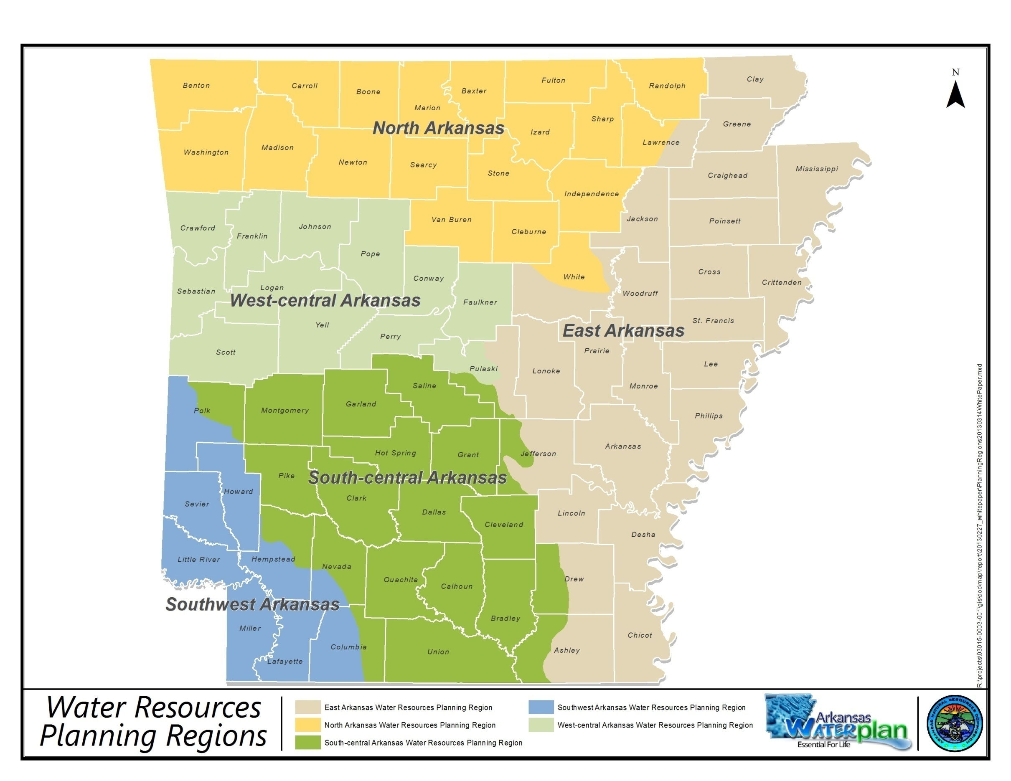

Slide 8
Workgroup Process
Five Regional Meetings
- Additional public meeting follows
- Same location –input on results from Subgroup meeting
All comments will be captured and included in Appendices to the updated Arkansas Water Plan

Slide 9
Workgroup Process
Solicit input on water issues and recommendations
Every issue and recommendation will be captured
Not all will be addressed In This Plan Update
All will be provided to appropriate agencies/organizations for consideration

Slide 10
Members Responsibility
Agree to attend all meetings
- Represent your sector – provide input
- Serve as a liaison for that sector in your region
- Read, synthesize information from others, present at regional meetings
- Have an alternate if can’t attend (Spokesperson)

Slide 11
Workgroup Process
Ground Rules
- Be prepared when arrive
- Request acknowledgement before speaking
- One speaker at a time
- Don’t interrupt
- Respect each others thinking/value their contributions

Slide 12
Workgroup Process
Ground Rules (Continued)
- Listen for understanding
- Ok to disagree – respectfully, openly
- No side conversations
- Stay on schedule
- Silence is agreement
Cell Phones off/on vibrate

Slide 13
Questions?

Slide 14
Today’s Meeting
Review preliminary set of issues
- 1990 Arkansas Water Plan
- 2013 Arkansas Water Plan public meetings
- ANRC Commissioners and staff
- Conservation District assessments, and
- Winthrop Rockefeller Foundation Water Issues in Arkansas Report
-

Slide 15
Today’s Meeting (Continued)
Add other issues, by sector:
- Ag – Irrigation + Livestock/Poultry
- F&W + Recreation
- Thermoelectric + Industry
- Public Water/Wastewater Providers
- Municipal/County Governments
- Navigation
- Conservation Districts

Slide 16
Process
1.5 Hours for Discussion
Report Out – 5 minutes/Sector Group
- New issues NOT in the preliminary list
- Focus on regional and statewide issues, not local => State Water Plan
- Focus on issues; recommendations come later
Facilitator/Reporter provided for each sector

Slide 17
Questions?

Slide 18
Sector Discussion Locations
Agriculture – Classroom
F&W + Recreation – Board Room
Thermoelectric + Industry – Table 1
Public Water/Wastewater - Table 2
Municipal/County Gov’t – Table 3
Navigation – Table 4
Conservation Districts – Table 5
Return for Report Out At 3:10

Slide 19
Report Out

Slide 20
Report Out – 5 Min/Combined Group
Ag – Irrigation + Livestock/Poultry
F&W + Recreation
Thermoelectric + Industry
Public Water/Wastewater Providers
Municipal/County Governments
Navigation
Conservation Districts

Slide 21
Comments?

Slide 22
Next Steps
Synthesize all issues identified today
Distribute to each member for review and use in eliciting other issues from their peers
Basis for discussion and prioritization in February Regional Meetings
Provide preliminary list of recommendations for these issues
Discuss recommendations at March Regional Meetings

Slide 23
Next Steps (Continued)
Statewide Meeting in April to discuss and prioritize recommendations
Prepare Draft Executive Summary in May
Conduct public meetings throughout the State in summer, early fall to discuss the Draft Plan
Finalize the Arkansas Water Plan and submit to the Arkansas Natural Resources Commission in November

Slide 24
February Regional Meetings*
East Region – Jonesboro – 18th
North Region – Mountain View – 19th
West-Central Region – Russellville – 20th
South-Central Region – Hot Springs – 24th
Southwest Region – Texarkana – 25th
* Tentative Schedule – Final Schedule distributed with Revised Issues List. Use Inclement Weather Policy for State Offices

Slide 25
February Regional Meetings
Present Gap analysis
Areas where 2050 demand projections exceed estimated supply
Discuss and prioritize issues
Highest regional priority issues by sector
Highest regional priority issues by category

Slide 26
Information and Your Input
Email additional comments, issues, concerns
Spokespersons or
twh@ftn-assoc.com
Arkansas Water Plan Website
www.arwaterplan.arkansas.gov
Website Addresses in Your Folders

Slide 27
Final Questions?

Slide 28
Thank You

